Slide 1
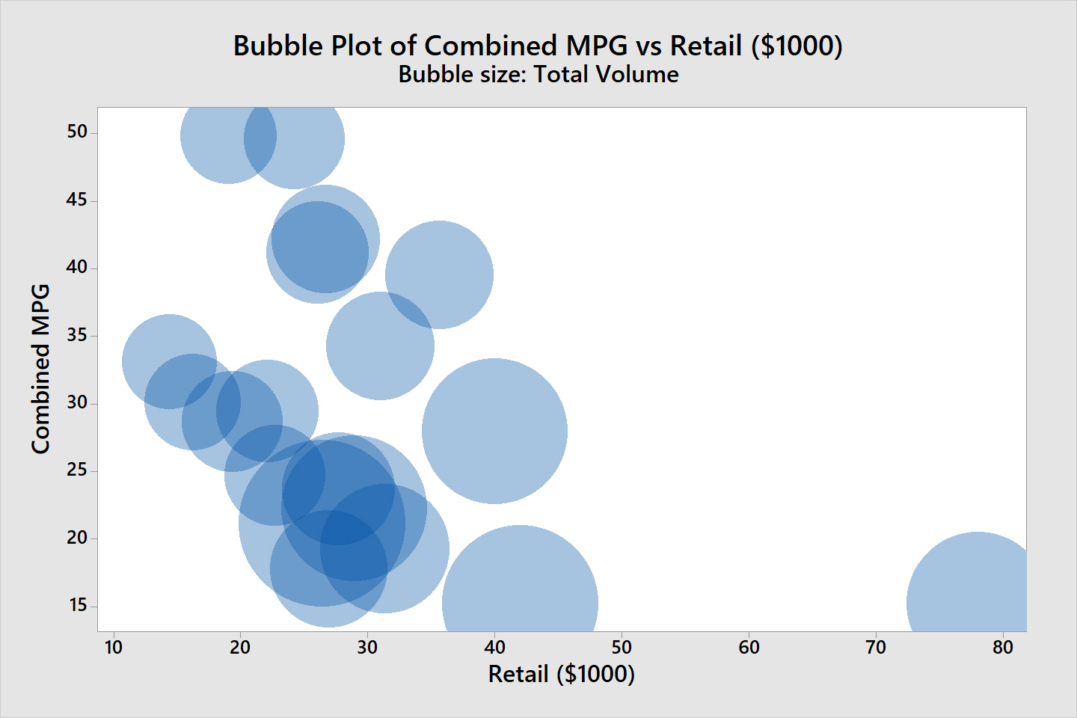
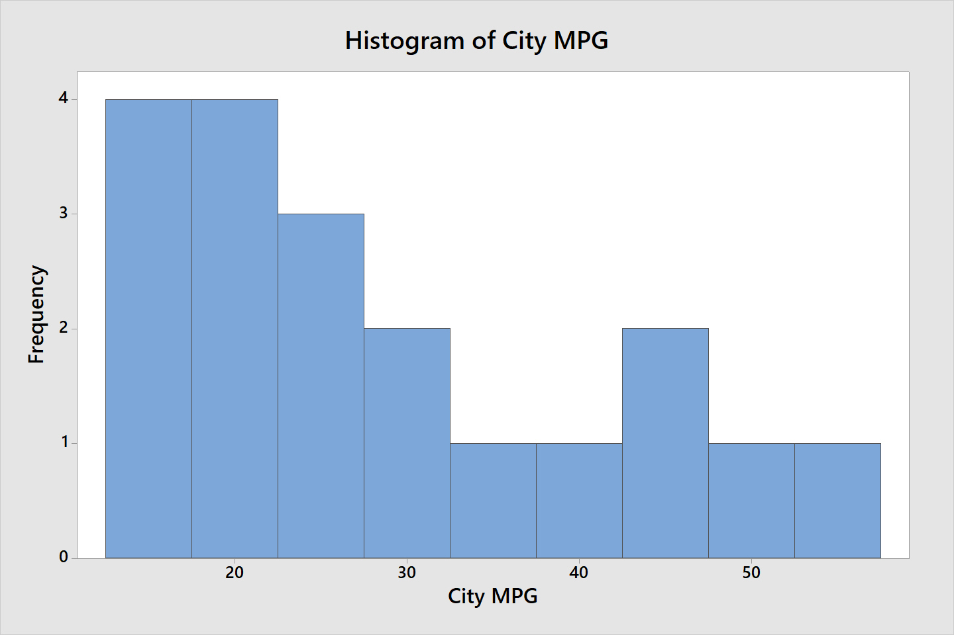
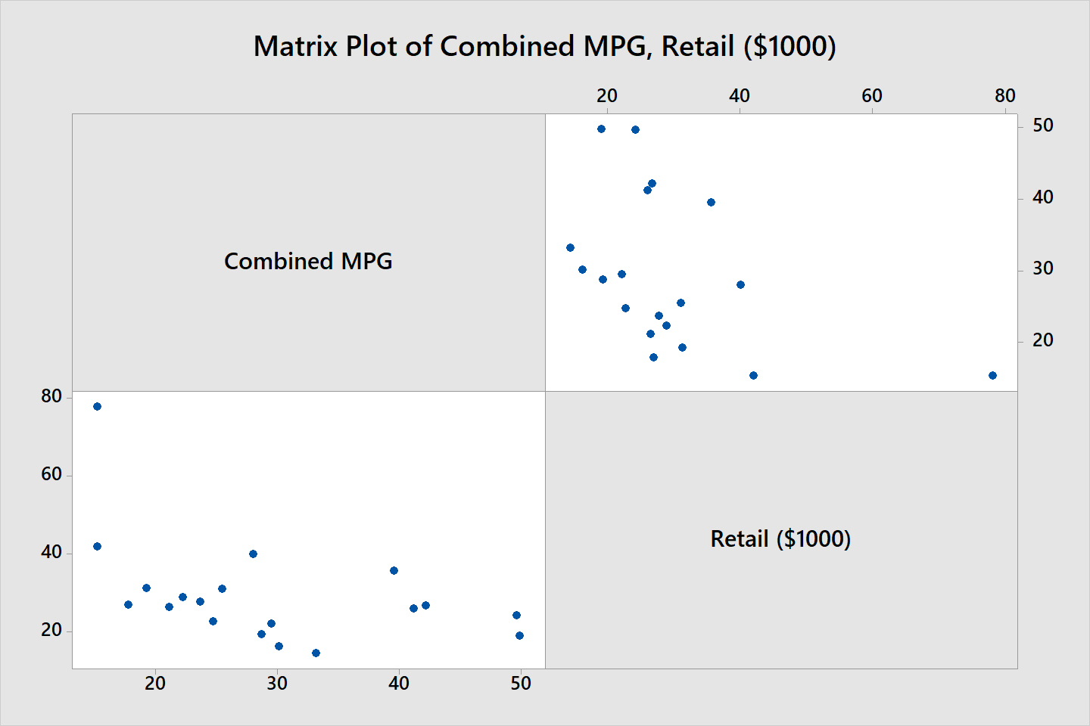
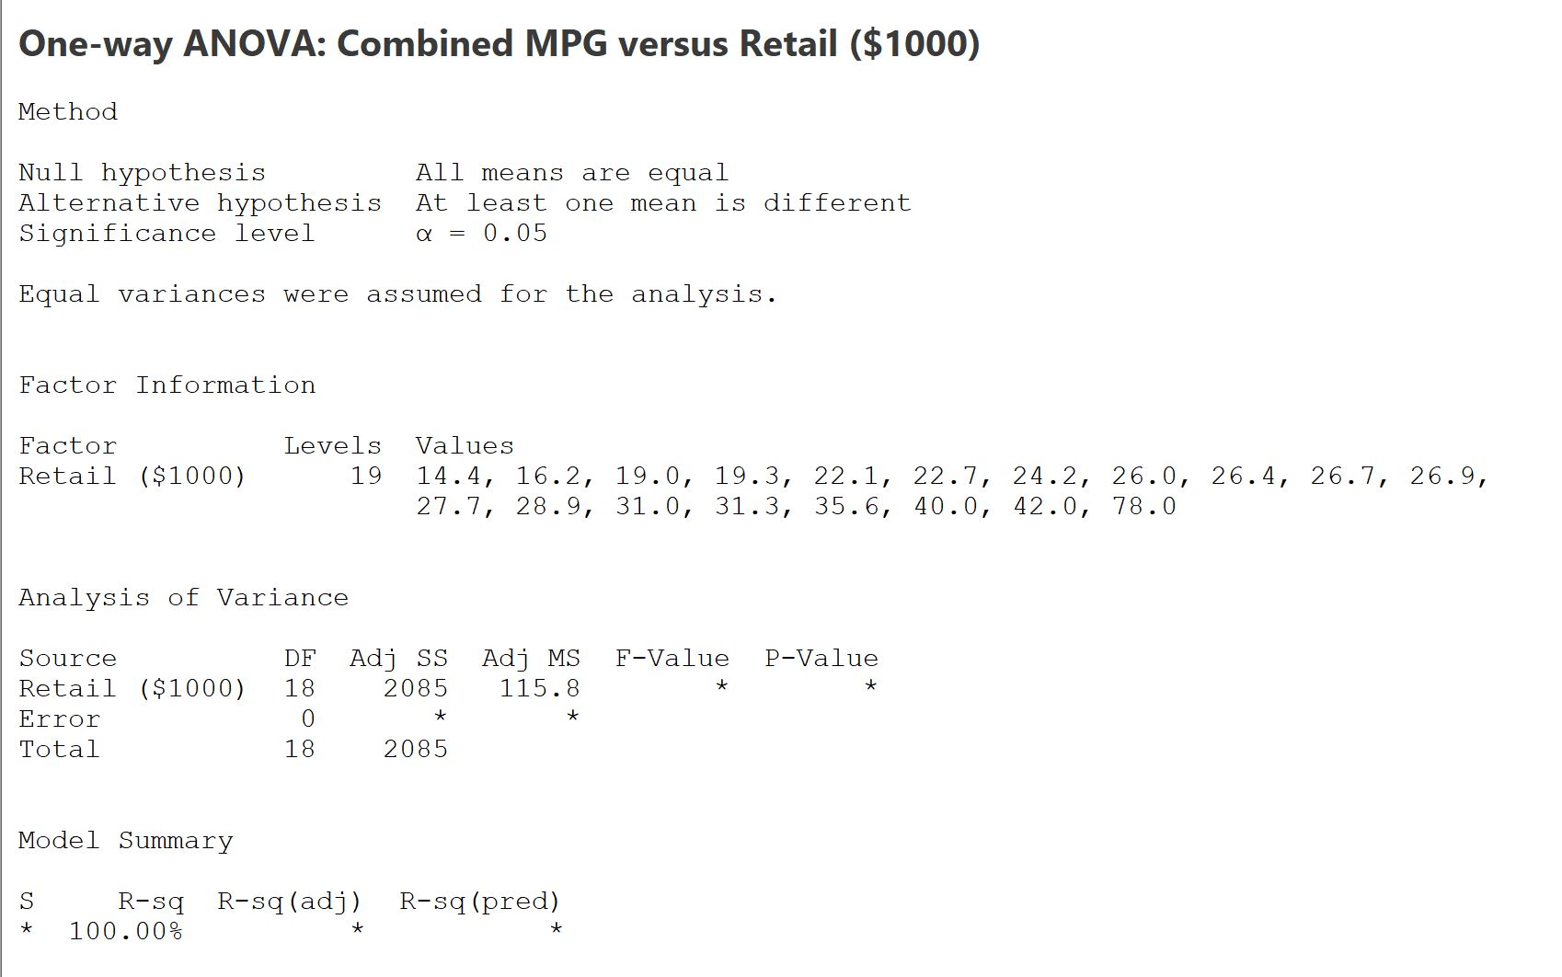
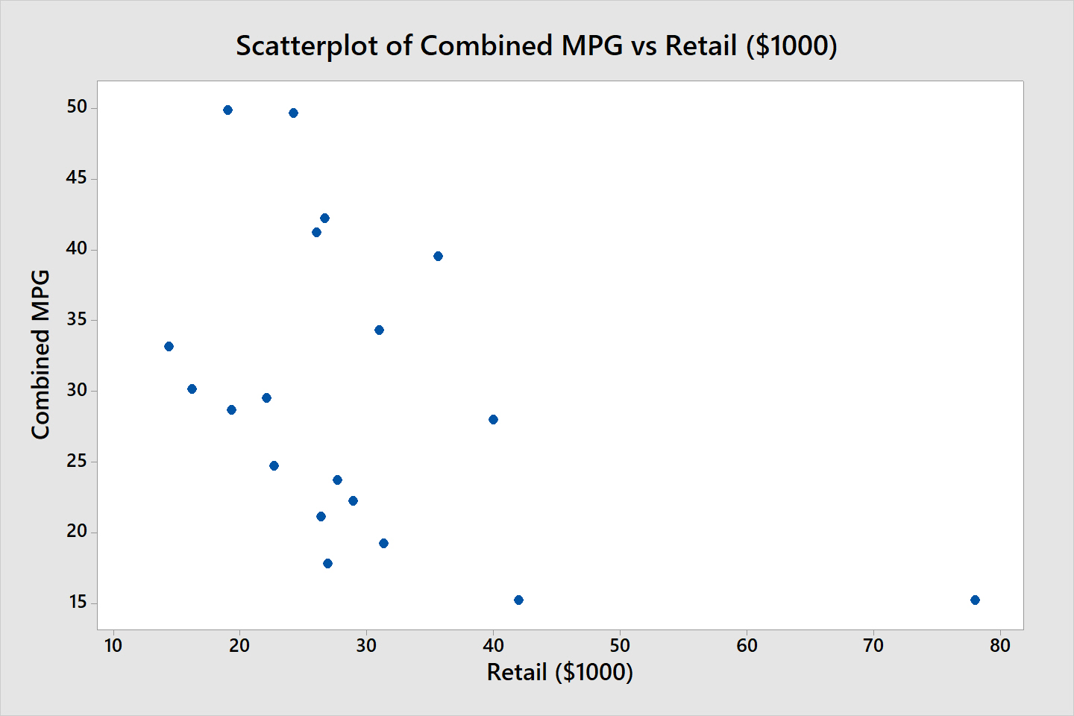
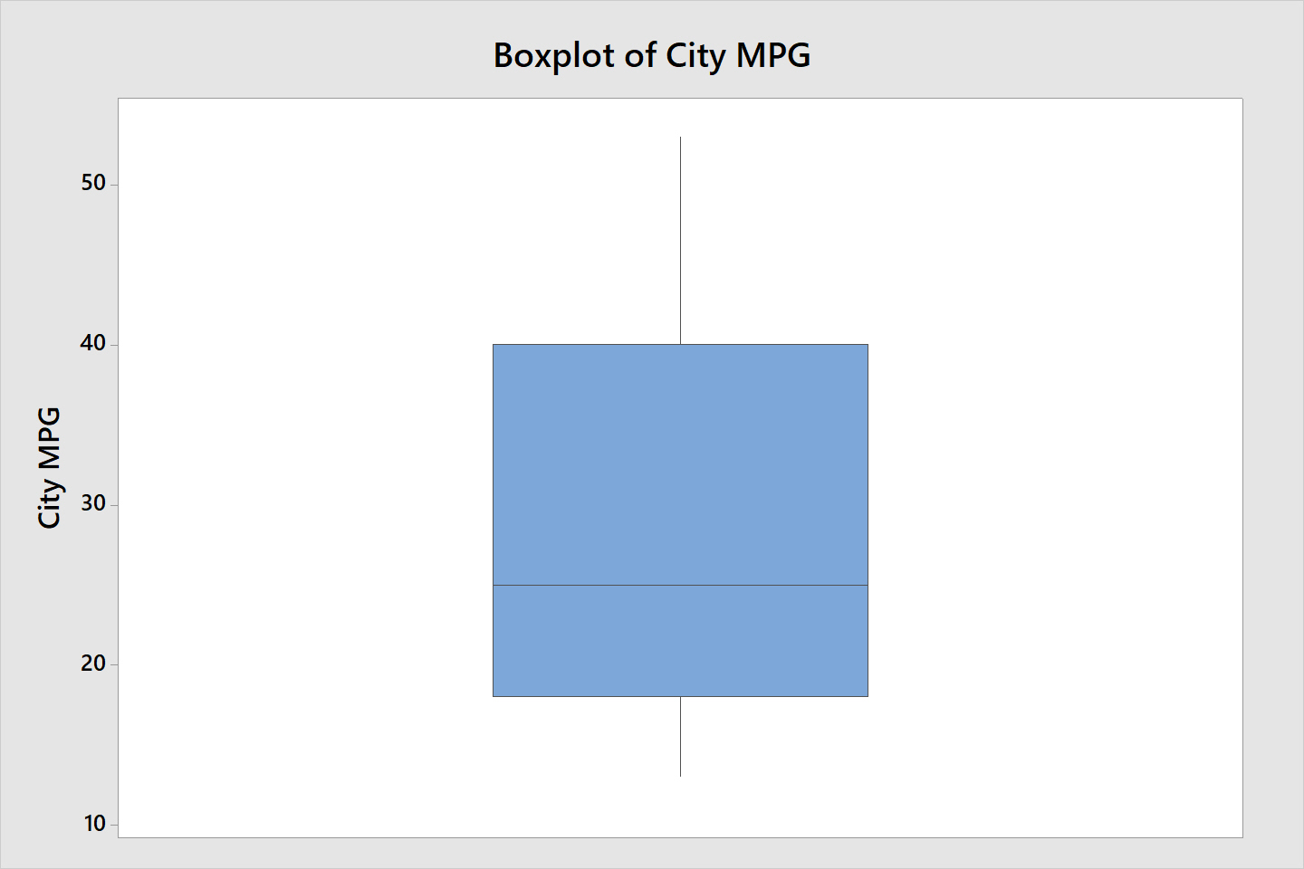
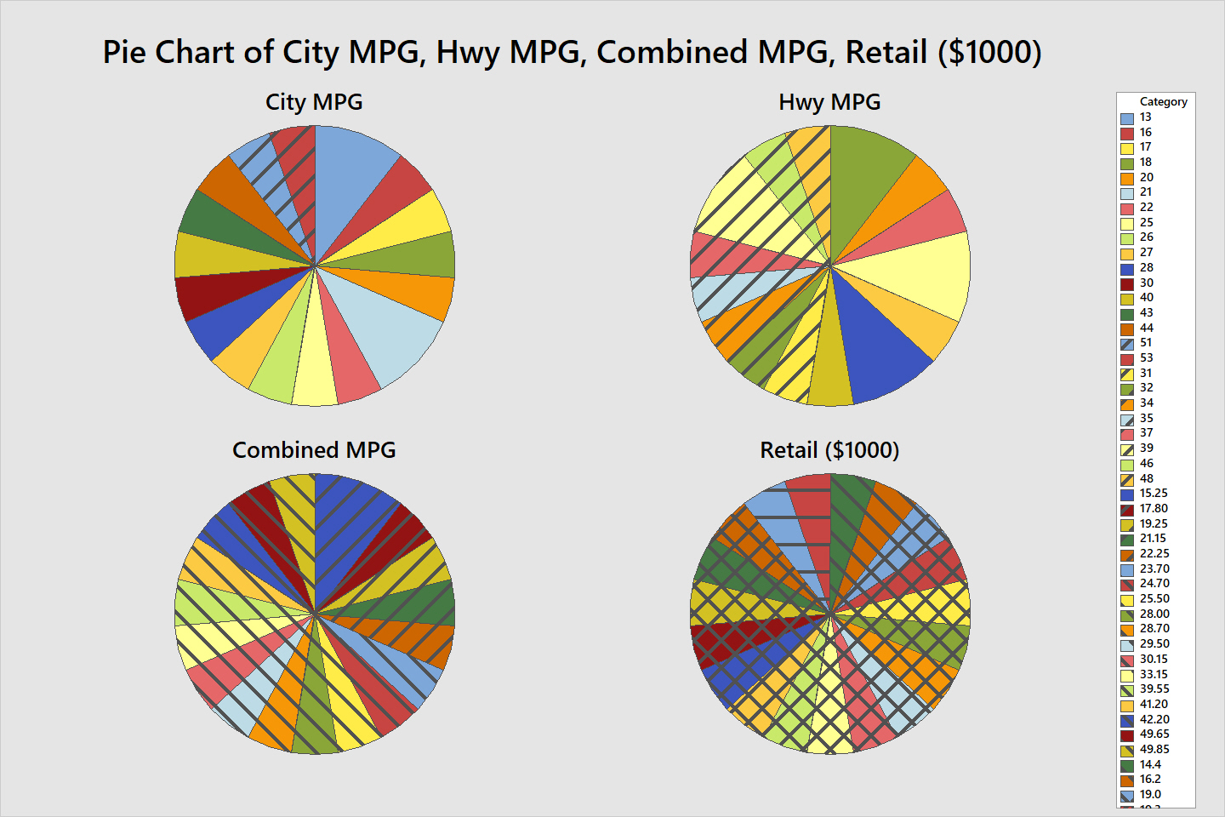
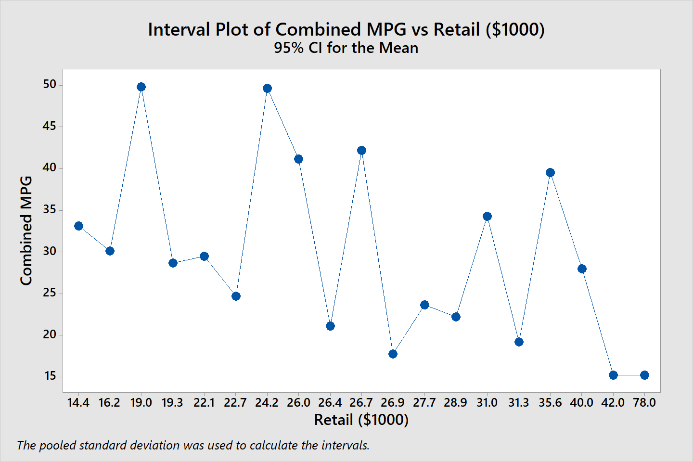
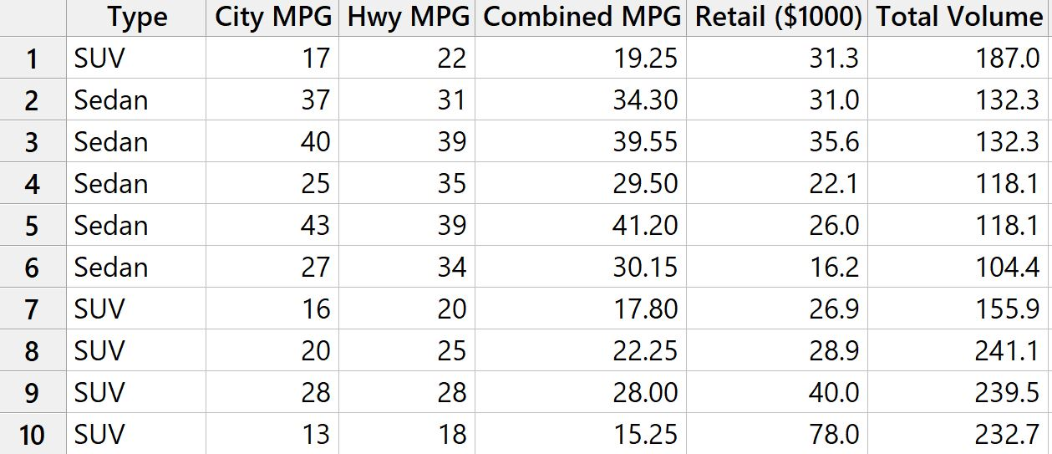
Exploratory Data Analysis
Nafisa Ali Anika; Roll:201636037
Graphs
Data Modeling
Dataset
Summery
In this poster, 6 major graphs(bubble plot, histogram, matrix plot, scatterplot, boxplot and pie chart) are shown for a particular dataset. Data modeling is also shown for that dataset. These analysis are done by Minitab software and these helped us to visualize our dataset.

